Slide 1
BLOG MANAGEMENT SYSTEM
UNDER THE GUIDANCE OF :
POOJA MEHTA
SUBMITTED BY:
1. Swanand Patil​
2. Pradeep Kumar Reddy Kudumula​
3. Shradhha Tak​

Slide 2
INTRODUCTION
The Blog Management System Project has been developed on AngularJS, NodeJS and Mysql. We are providing angularjs projects with source code, database, and documentation. This application is very simple and impressive.
The main objective behind this angularjs application Blog Management System is to provide simple blog system to share the information and thoughts on many topics. There is a role user that is admin in this project who can only post the blog. User can read the blog ,like or dislike the blog, comment on the blog . In this project only Admin can update or delete the blog which admin created himself.

Slide 3
PROJECT OBJECTIVE
The purpose of our application is to provide customers with a convenient and user-friendly platform to post the blog and view or read the blog. It aims to make the easy for user in such that way user can view or read the blog according to their interested topics like sports, politics, jobs etc.​
This major Java Online Blog Management System provides online interface and the users can easily view the blog and read the blog. There are various features available in Blog Management System. As this online application enables the users to register either as the user or admin. As only Admin can post the blog and user can able to only read that blog and like or dislike the blog. Also user can comment on particular blog. The admin can easily post blog of their choice. For posting the blog user needs to register into the system with role as Admin and after the registration, user can post the blog on the selective topics. ​
​

Slide 4
TECHNOLOGY USED
JAVA
Java is an object-oriented programming (OOP) language, which means it supports the principles and concepts of object-oriented programming.
Java
HTML
angular
HTML, which stands for HyperText Markup Language, is the standard markup language used for creating and structuring web pages.
ANGULAR
Angular is a TypeScript-based framework that uses HTML, CSS, and JavaScript to build robust and scalable single-page applications.
Postman
POSTMAN
JAVASCRIPT
Postman is a popular collaboration platform and toolset used by developers to build, test, and document APIs
JavaScript is a widely used programming language primarily used for web development.

Slide 5
PROPOSED SYSTEM
Blogging platforms are broadcast-style communications systems that enable authors to publish articles, opinions or product reviews (known as posts), and are aimed to provide a seamless and user-friendly to view and get information at their fingertips.
Given comprehensive full-stack project combines the power of Java Spring Boot, Hibernate, MySQL, and Angular. This system aims to address the challenges of modern web development by utilizing Java Spring Boot for rapid backend development, Hibernate for seamless communication with the MySQL database, and Angular for creating dynamic and interactive user interfaces. By leveraging these technologies, we can deliver a robust, scalable, and user-friendly application that meets the demands of today's web development landscape.

Slide 6
REQUIRED SPECIFICATIONS
HARDWARE CONFIGURATION | SOFTWARE CONFIGURATION
Operating System : Windows 10 and above | Software IDE: Eclipse, Postman, MySQL, VS Code.
Hard Disk: 500 GB | Language: JAVA, Type Script, HTML, CSS
RAM: 8 GB | Front End: Angular, Boot Strap
 | Back End: Spring Boot, MySQL.

Slide 7
MODULES
Admin- Login and Manage​
Comment-User comment in blog and like,dislike
User-Signup and Login
​Blog List- User read the blog
Create blog- Create/ Update the blog by admin

Slide 8
SPRING NOTATATIONS
@Controller : | The @Controller annotation indicates that a particular class serves the role of a controller. Spring Controller annotation is typically used in combination with annotated handler methods based on the @RequestMapping annotation.
@Autowired | The @Autowired annotation provides more fine-grained control over where and how auto-wiring should be accomplished. Autowiring feature of spring framework enables you to inject the object dependency implicitly. It internally uses setter or constructor injection.
@RequestMapping | The @RequestMapping is one of the most common annotation used in Spring Web applications. This annotation maps HTTP requests to handler methods of MVC and REST controllers.
@Entity | The @Entity annotation specifies that the class is an entity and is mapped to a database table.
@Table | The @Table annotation is used to create a table in database.
@JoinColumn | The @JoinColumn is used to specify a column for joining an entity association or element collection.

Slide 9
SPRING NOTATATIONS
@PutMapping | The @PutMapping is used for update the records.
@PostMapping | The @PostMapping is used to create a resource Mapping.
@GetMapping | The @GetMapping is used to read all the inserted records.
@DeleteMapping | The @DeleteMapping is used to delete the records.
@PathVariable | The @Path Variable annotation is used to extract the value from the URL.
@RequestParam | The @RequestParam annotation is used to read the form data and bind it automatically to the parameter present in the provided method.

Slide 10
SPRING NOTATATIONS
@Request Body | The @RequestBody annotation is applicable to handler methods of spring controller. spring should deserialize a request body into an object.
@OneToOne Mapping | The @OneToOne JPA annotation is used to map the source entity with the target entity, Hibernate maps the tables in your database to the Entity classes in your application.
@OneToMany Mapping | The @OneTo-Many relationship between table A and table B indicates that one row in a table A link to many rows in table B but one row in table B links to only one row in table A.
@ManyToOne Mapping | The @Many-to-One mapping means that many instances of this entity are mapped to one instance of another entity.
@ExceptionHandler | The @ExceptionHandler is an annotation used to handle the specific exceptions and sending the custom responses to the client.
@ControllerAdvice | A controller advice allows you to use exactly the same exception handling techniques but apply them across the whole application, not just to an individual controller. You can think of them as an annotation driven interceptor.

Slide 11
CONCLUSION
In summary, a blog management system developed using Java, SQL, Angular, and Spring combines the power of back-end development, database management, front-end interactivity, and framework support to create a comprehensive and efficient solution. It enables the seamless management of blog content, enhances user experience, and provides necessary administrative tools for efficient system maintenance.

Slide 12
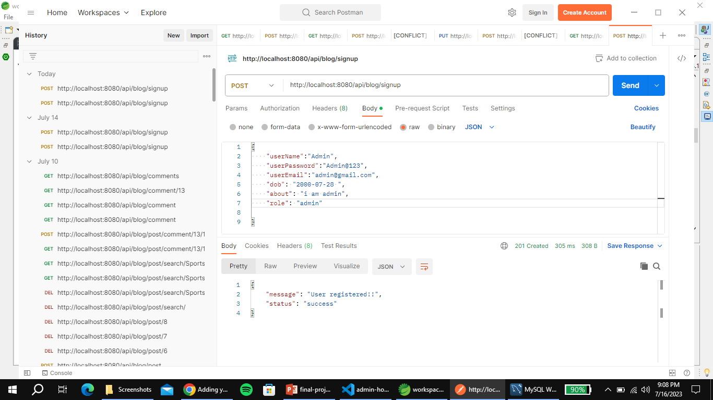
ADMIN REGISTRATION FROM POSTMAN

Slide 13
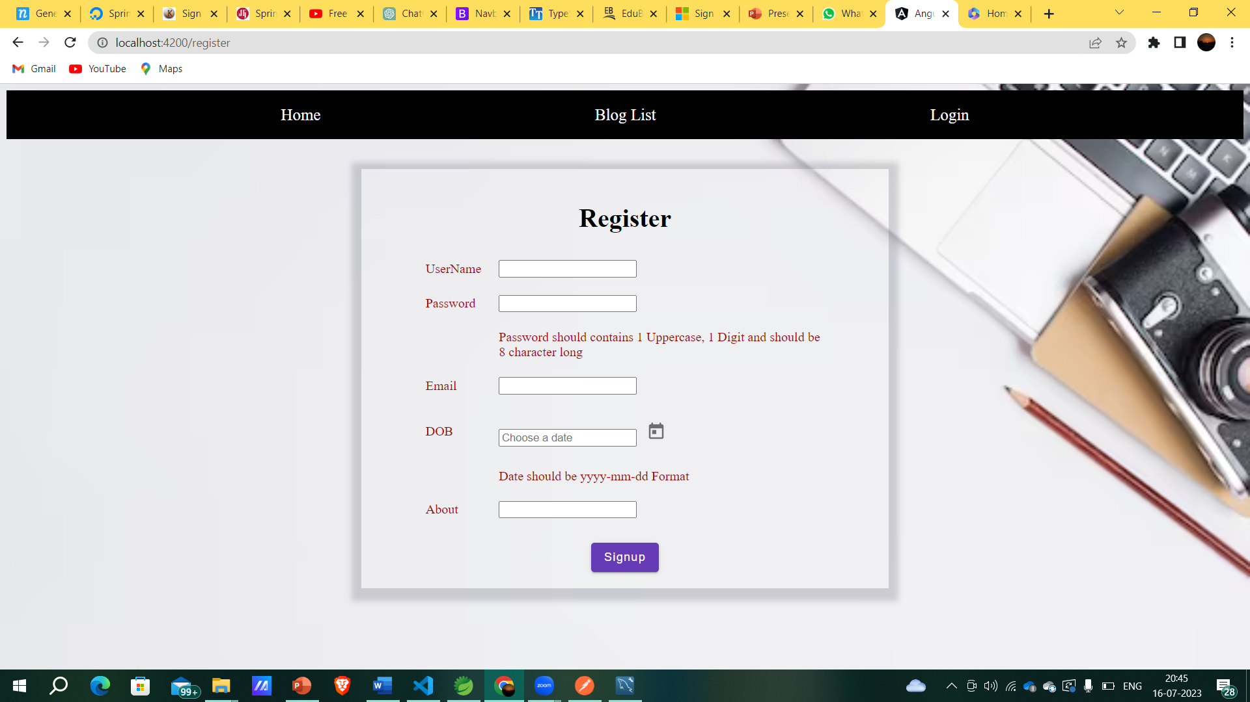
USER REGISTRATION

Slide 14
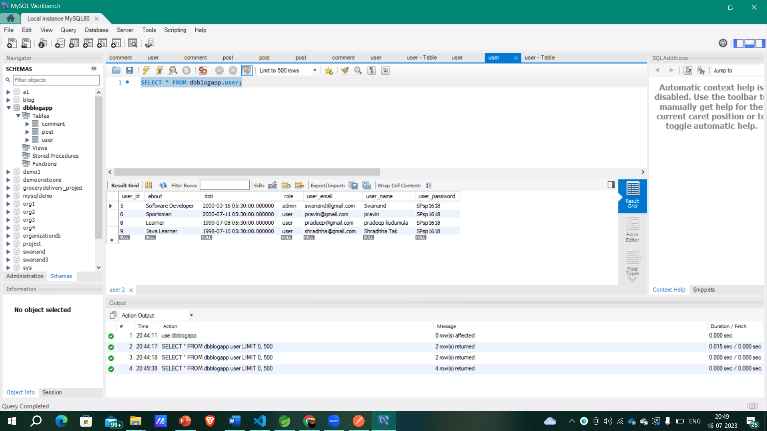
USER TABLE

Slide 15
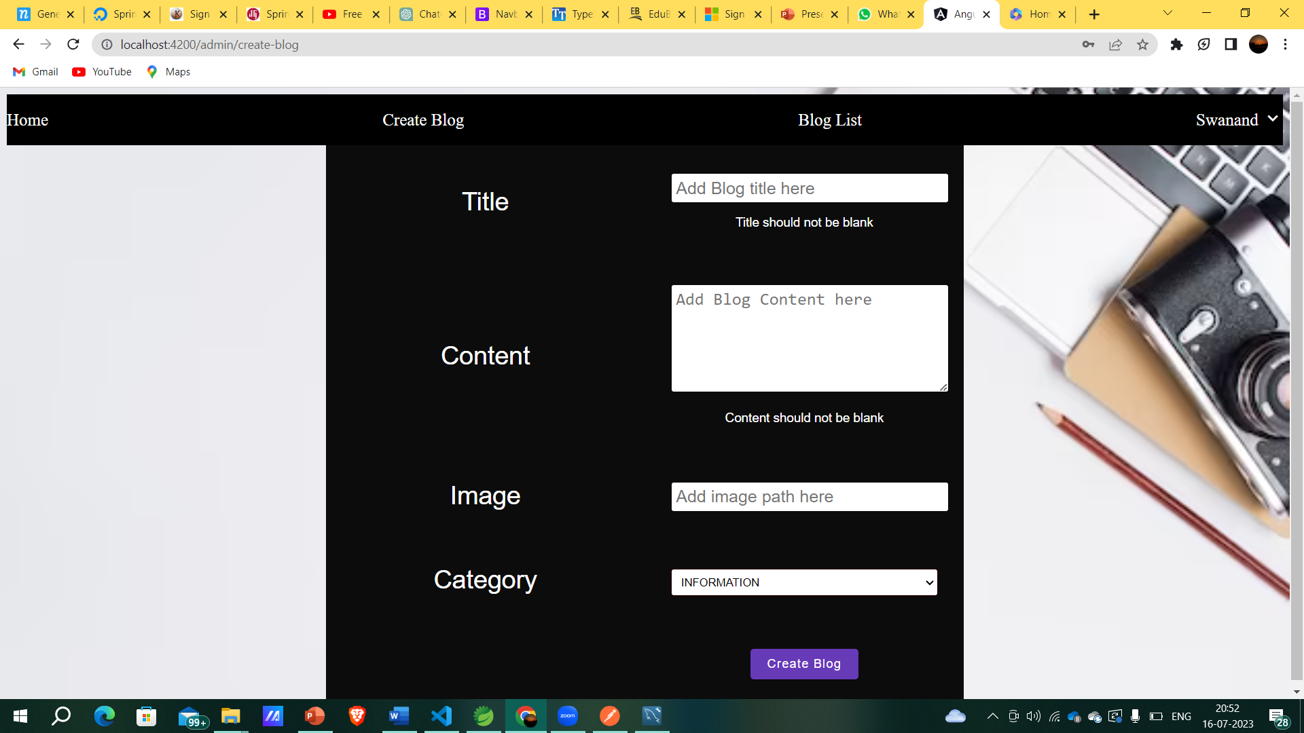
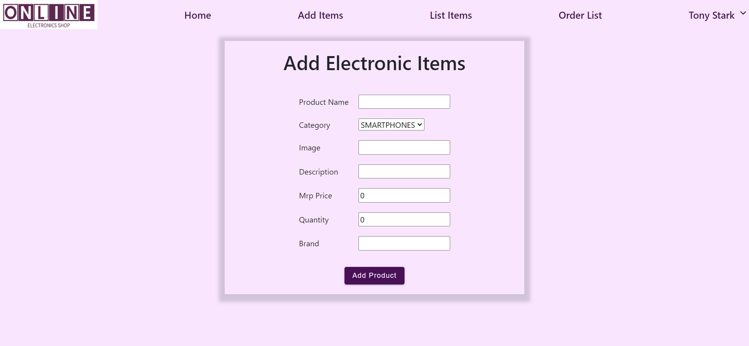
CREATE BLOG FROM ADMIN

Slide 16
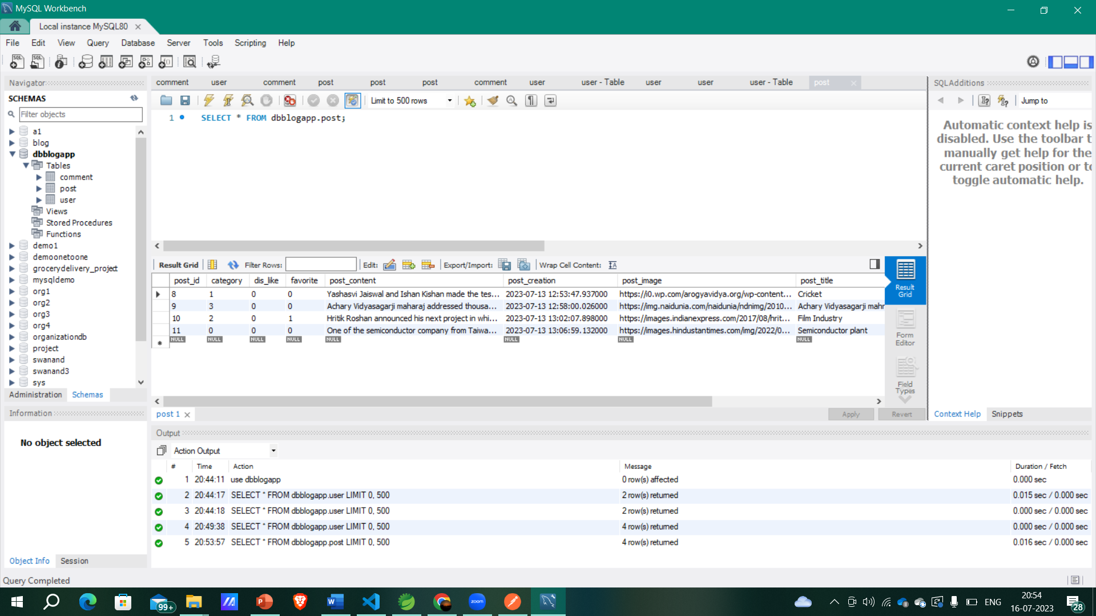
BLOG POST TABLE

Slide 17
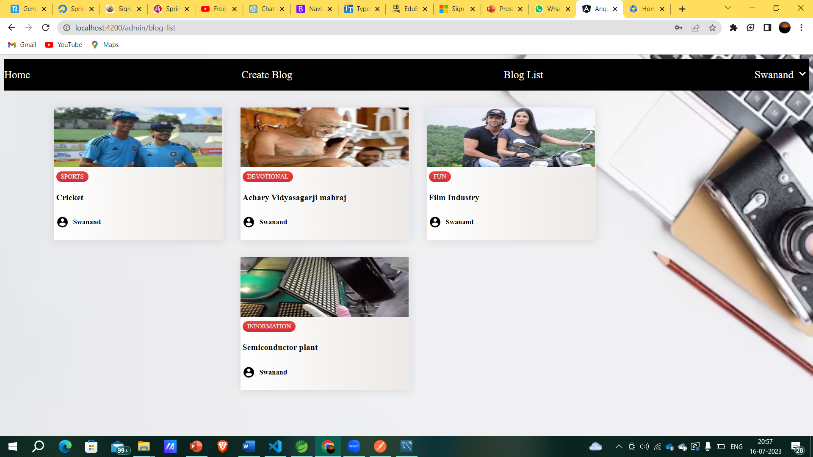
BLOG LIST

Slide 18
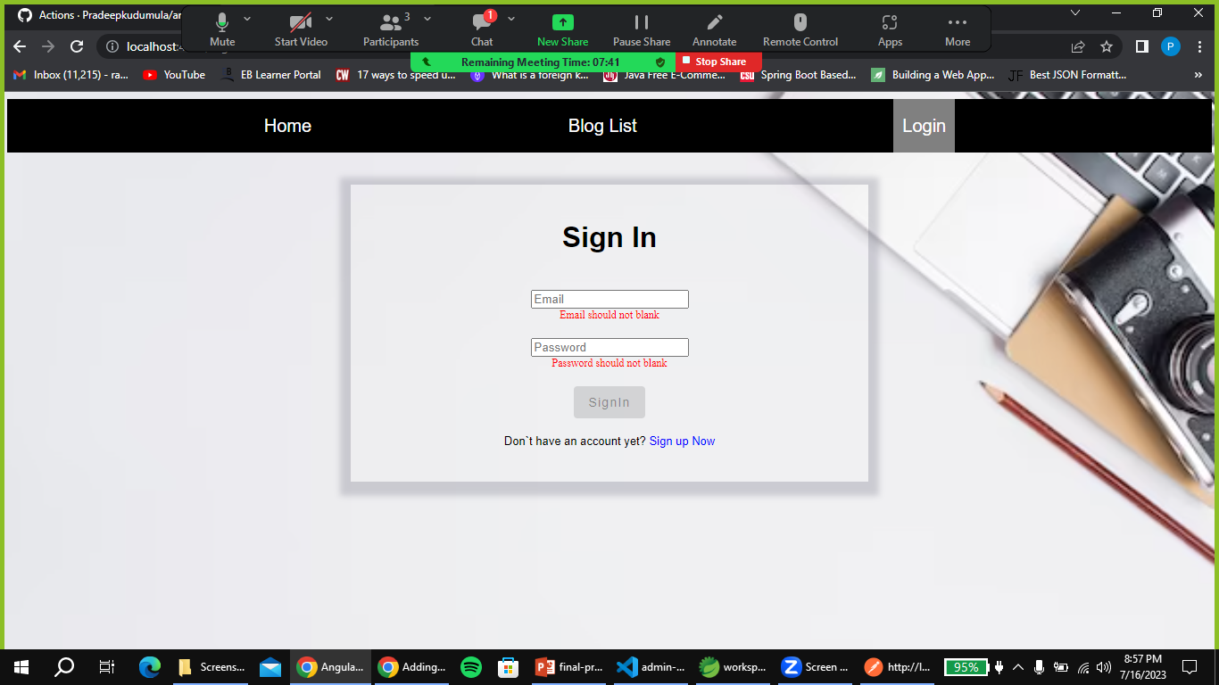
USER SIGNIN

Slide 19
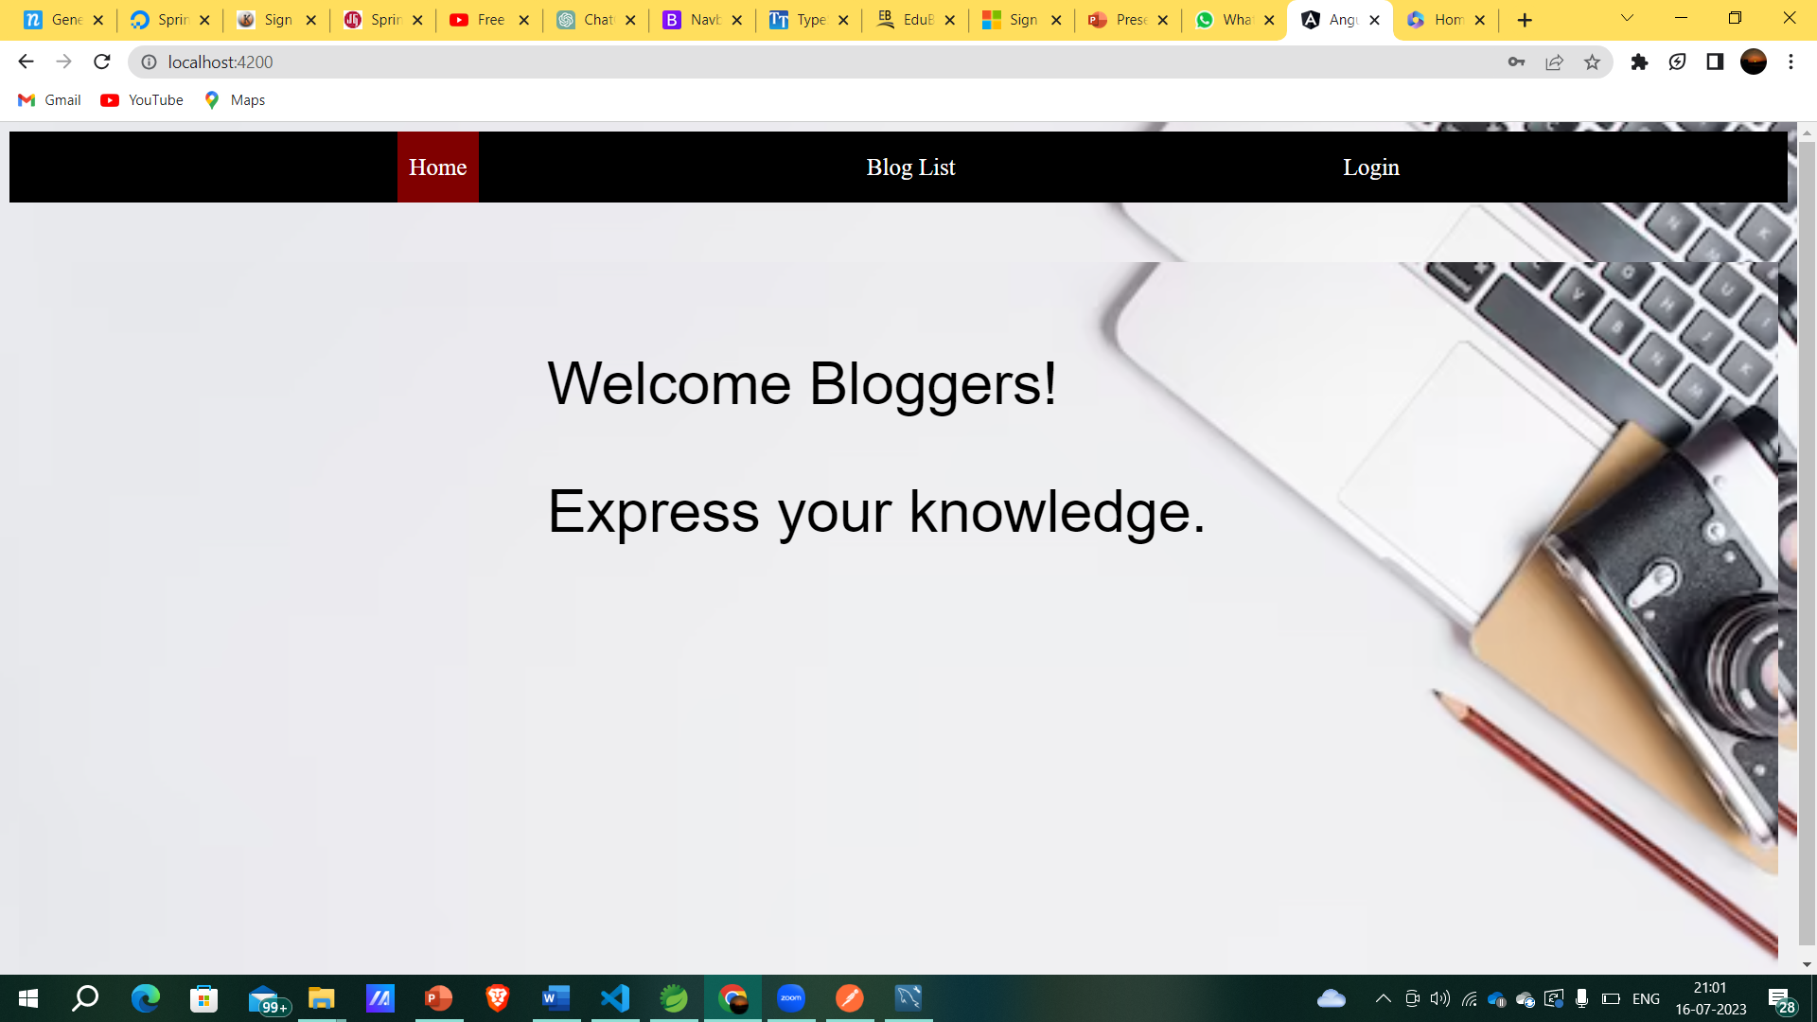
HOME PAGE

Slide 20
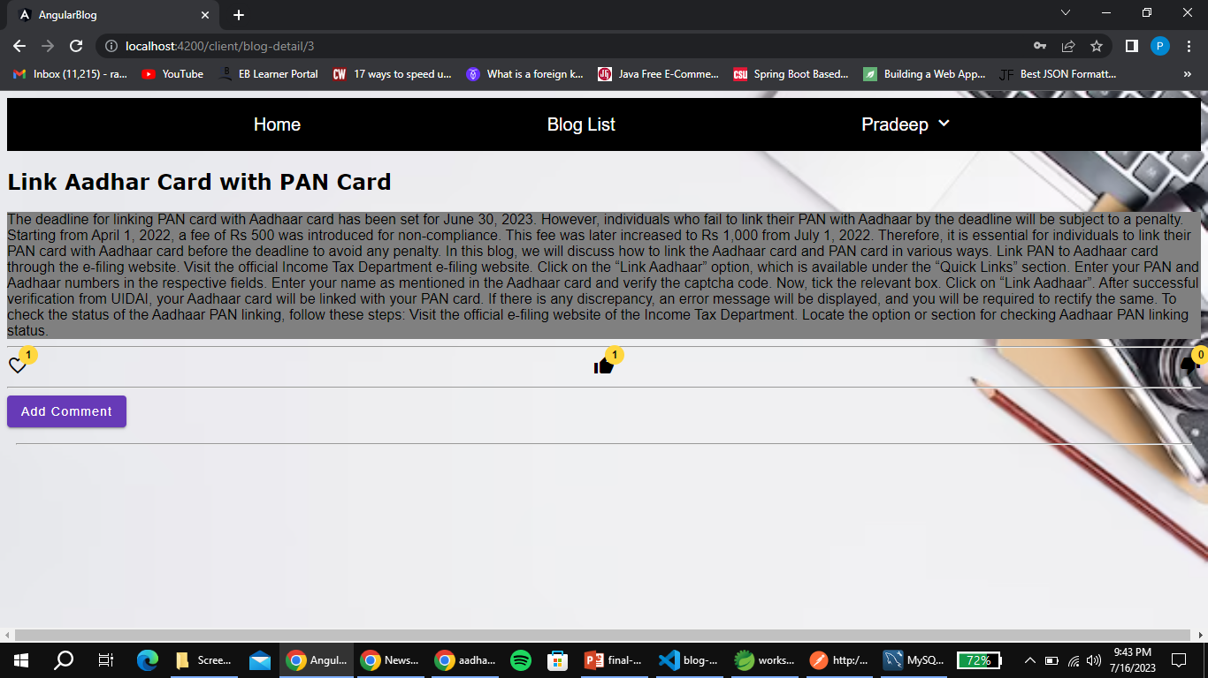
BLOG CONTENT

Slide 21
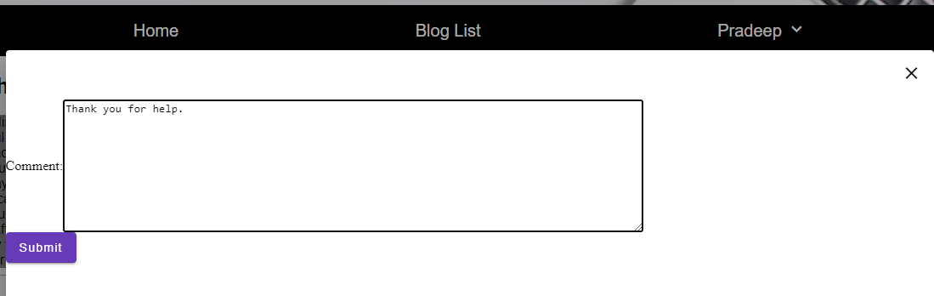
ADD COMMENT

Slide 22
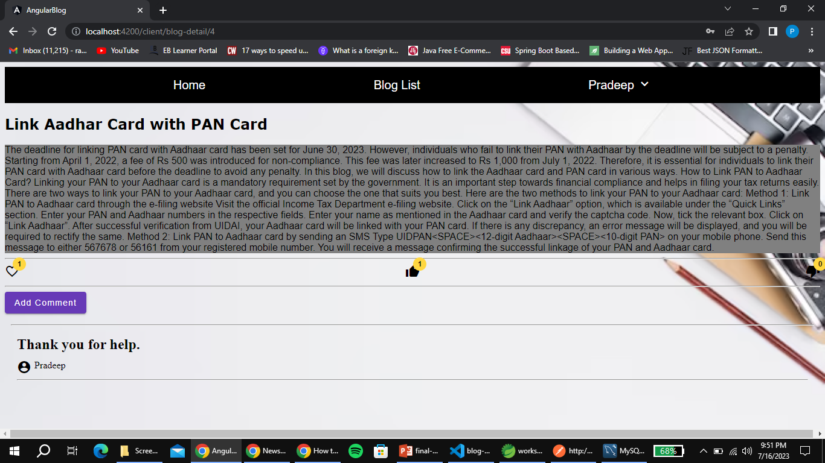
View Comment

Slide 23
THANK YOU

